Slide 1

NSG Pilkington – University of Liverpool Machine Learning Project: 28/04/2021
Dr. Peter Green
Diego Echeverria
Sarini Jayasinghe
Risk Institute,
School of Engineering

Slide 2
Today
Removing coating periods
Presenting model performance
Combination signals
Exploring fault density by modules at the coating region
ISRA5D Fault Data

Slide 3
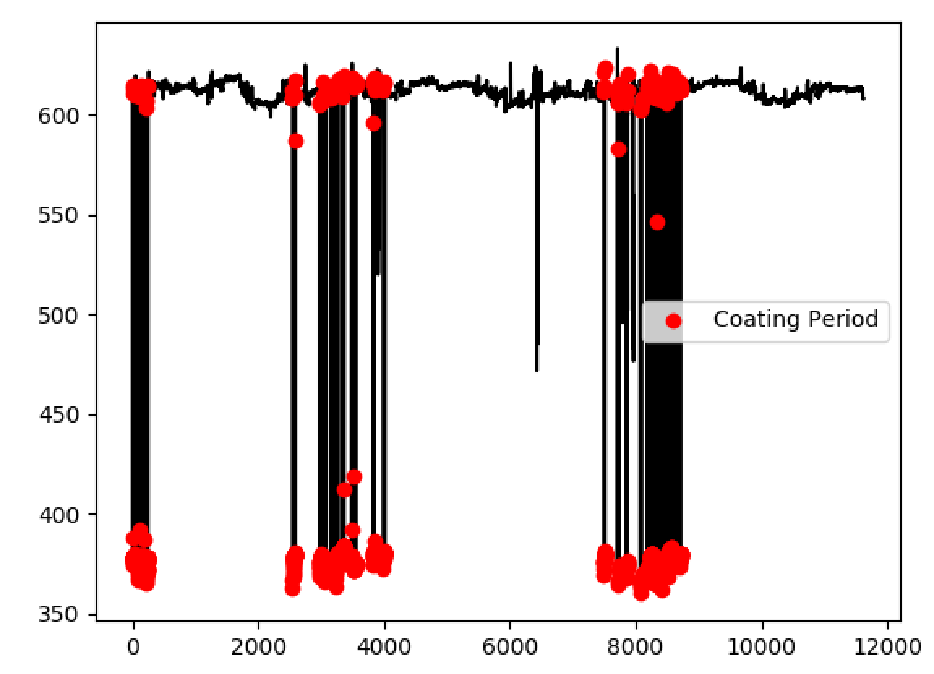
Removing Coating Periods

Slide 4
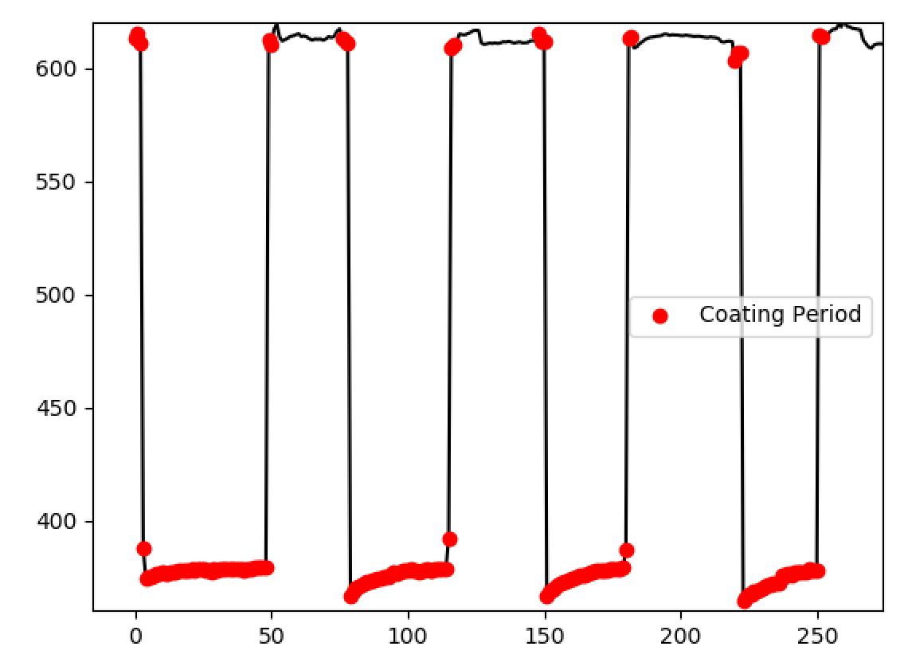
Removing Coating Periods
So initial model training was actually being conducted using data that included coating periods!

Slide 5
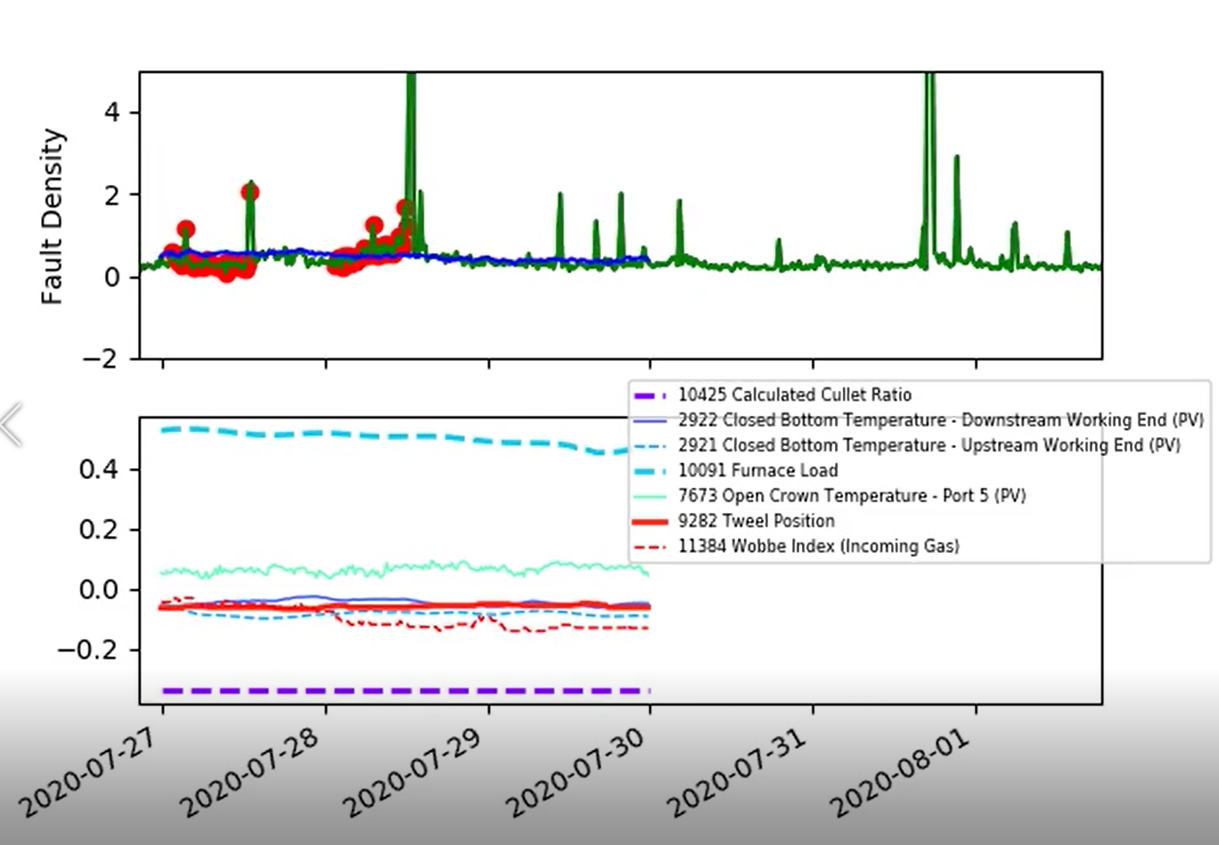
Removing Coating Periods
Coating periods are now ignored (in both initial training data and in the online parameter updates).
Note we still ignore data points move than 5 from the model’s predictions.

Slide 6
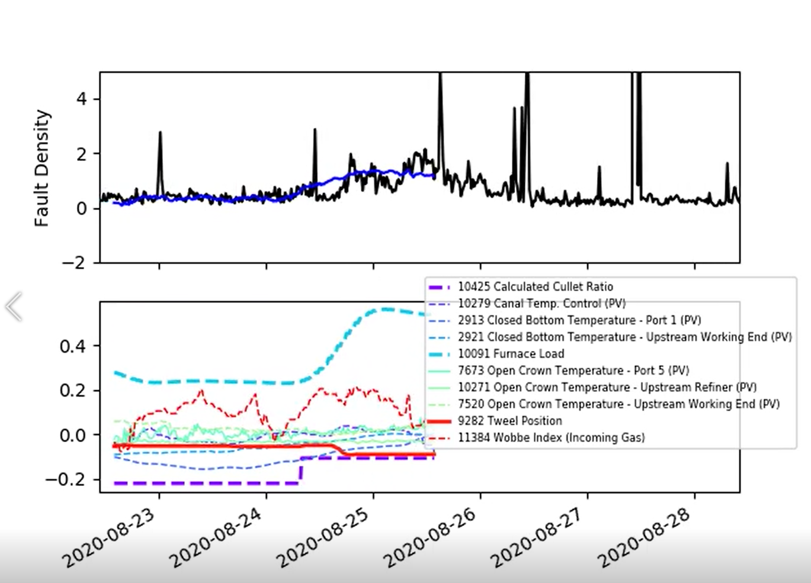
Removing Coating Periods
Coating periods are now ignored (in both initial training data and in the online parameter updates).
Note we still ignore data points move than 5 from the model’s predictions.

Slide 7
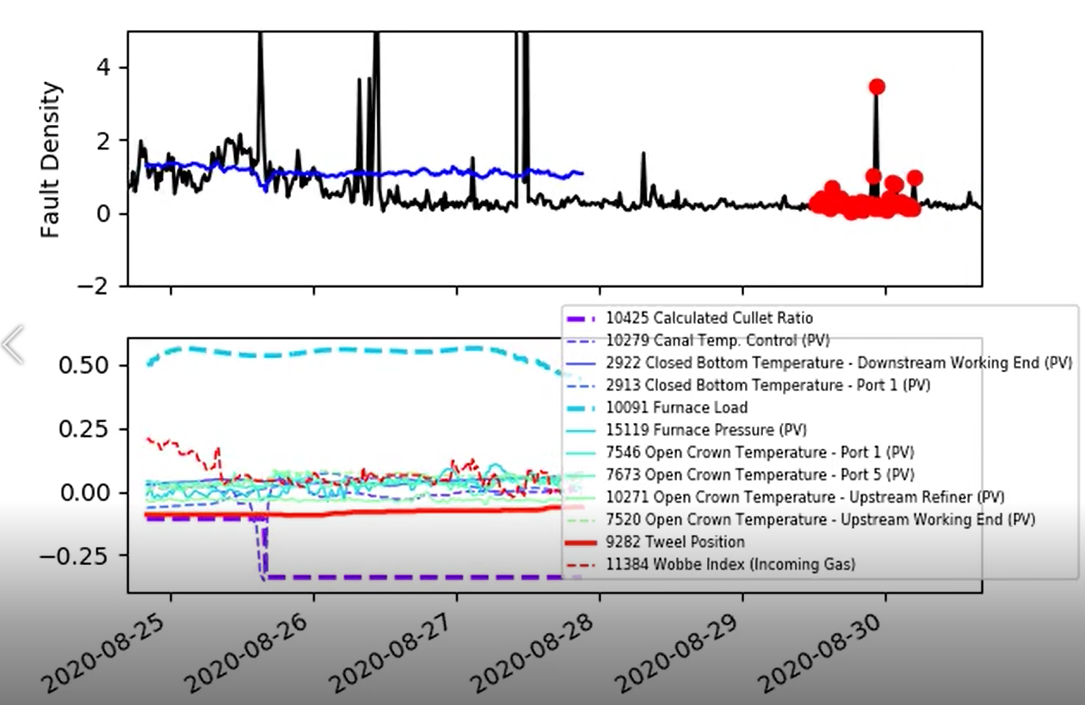
Removing Coating Periods
Coating periods are now ignored (in both initial training data and in the online parameter updates).
Note we still ignore data points move than 5 from the model’s predictions.

Slide 8
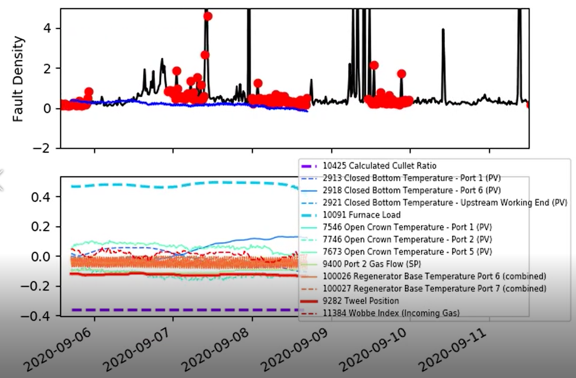
Removing Coating Periods
Coating periods are now ignored (in both initial training data and in the online parameter updates).
Note we still ignore data points move than 5 from the model’s predictions.

Slide 9
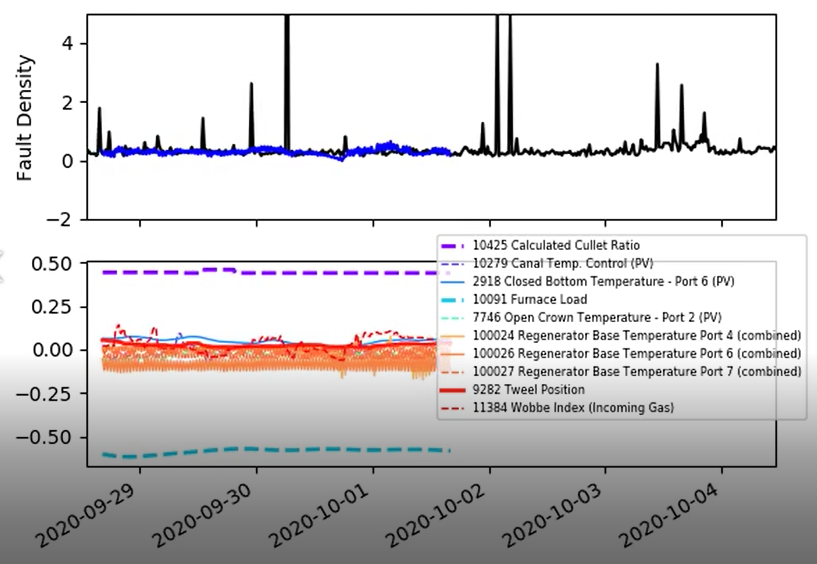
Removing Coating Periods
Coating periods are now ignored (in both initial training data and in the online parameter updates).
Note we still ignore data points move than 5 from the model’s predictions.

Slide 10
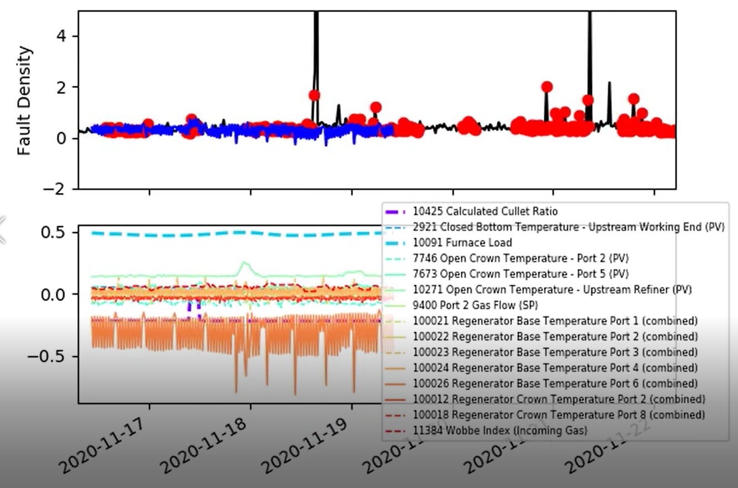
Removing Coating Periods
I would still like to have a closer look at these…
Coating periods are now ignored (in both initial training data and in the online parameter updates).
Note we still ignore data points move than 5 from the model’s predictions.

Slide 11
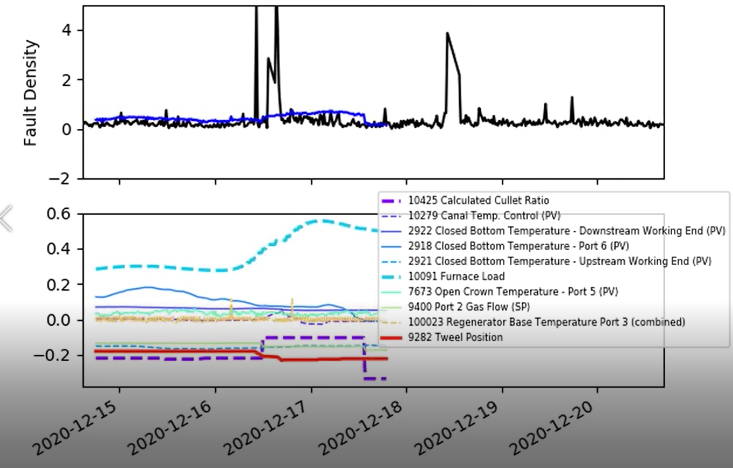
Removing Coating Periods
Coating periods are now ignored (in both initial training data and in the online parameter updates).
Note we still ignore data points move than 5 from the model’s predictions.

Slide 12
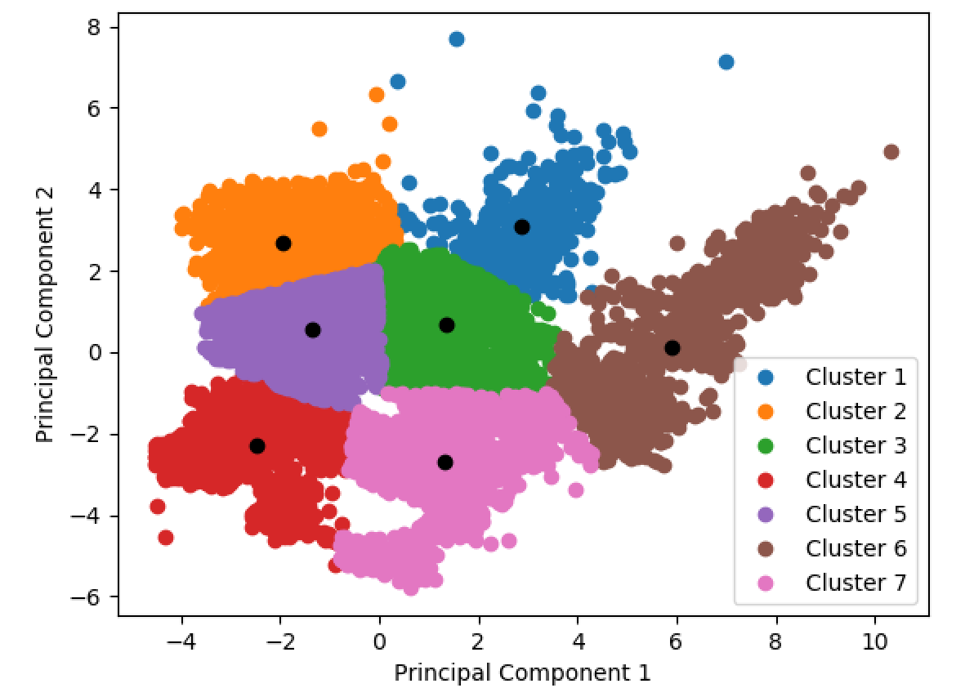
Presenting Model Performance
We could include a line on the PCA plot, indicating if the furnace is moving into a different state in the next 72 hours?
Compare with a different (less interpretable) model?

Slide 13
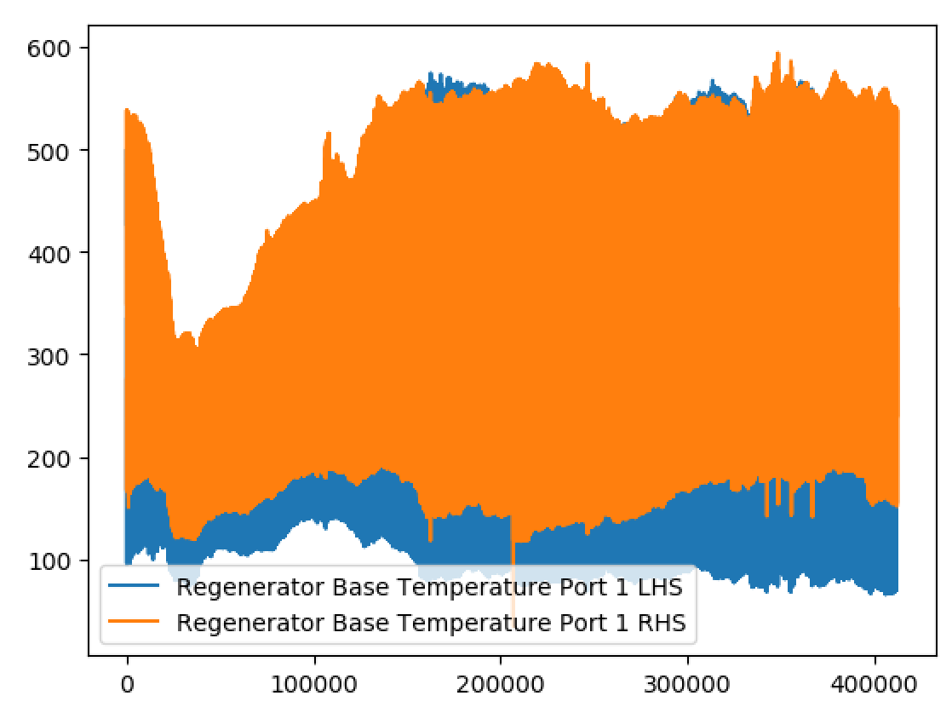
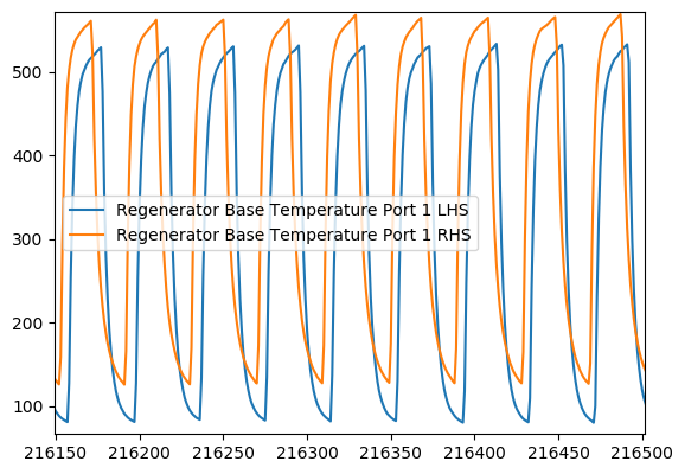
Combination Signals (Example)
Regenerator Base Temperature Port 1 LHS vs Regenerator Base Temperature Port 1 RHS…

Slide 14
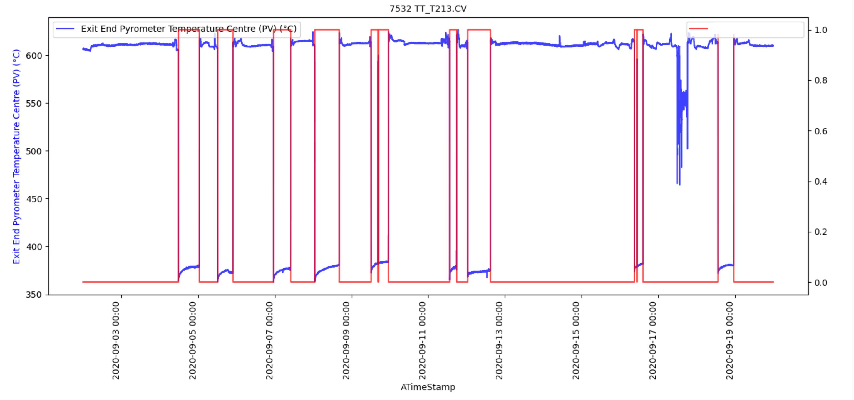
Exploring fault density by modules at the coating region

Slide 15
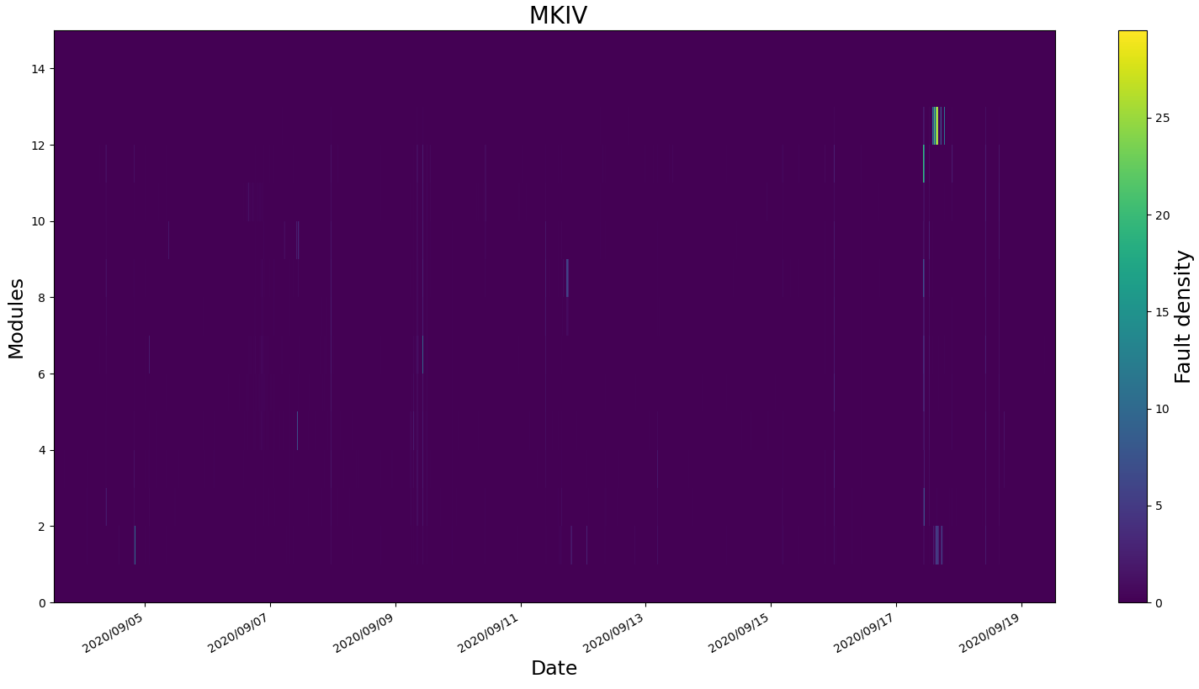
Exploring fault density by modules at the coating region

Slide 16
Exploring fault density by modules at the coating region

Slide 17
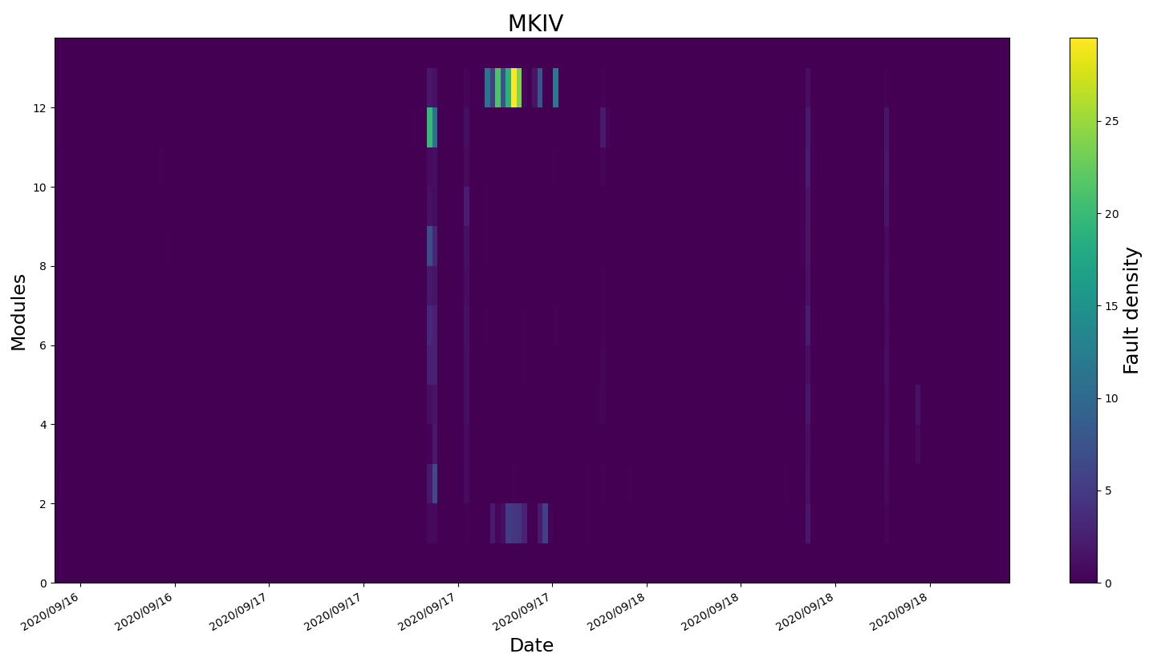
Exploring fault density by modules at the coating region

Slide 18
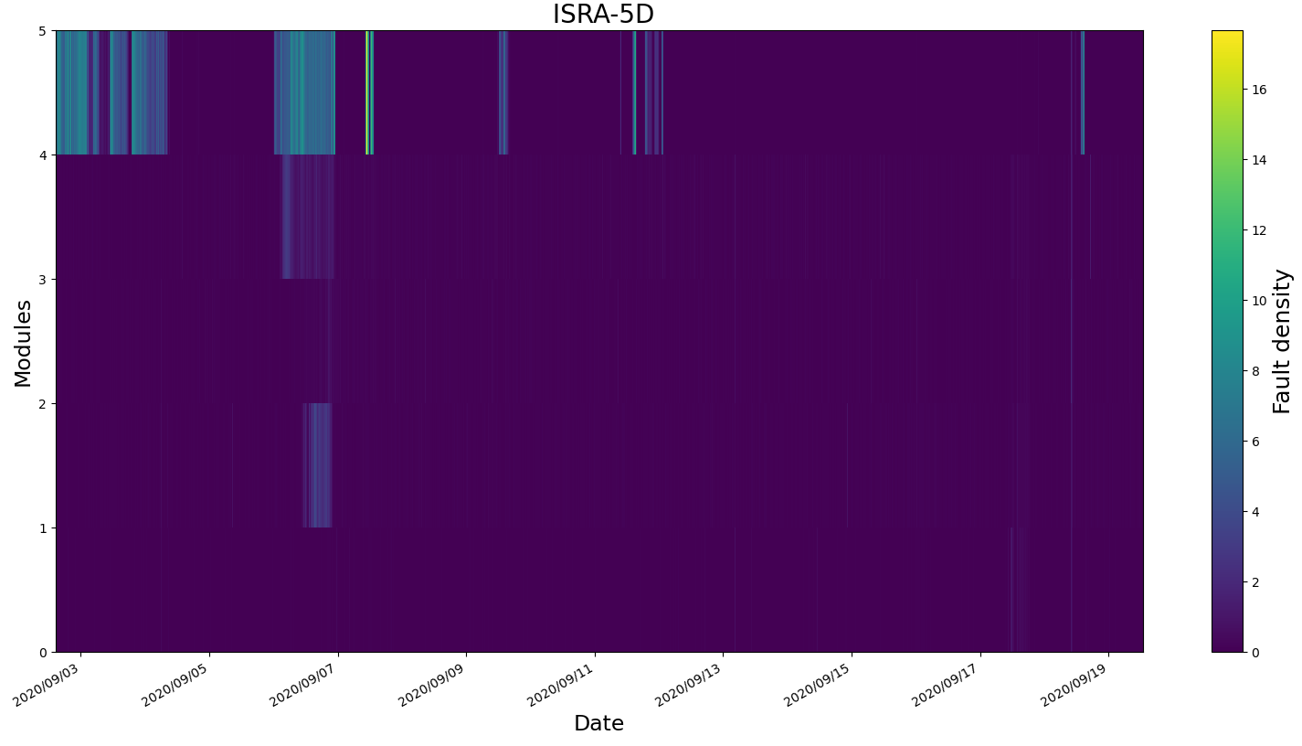
Exploring fault density by modules at the coating region

Slide 19
Exploring fault density by modules at the coating region

Slide 20
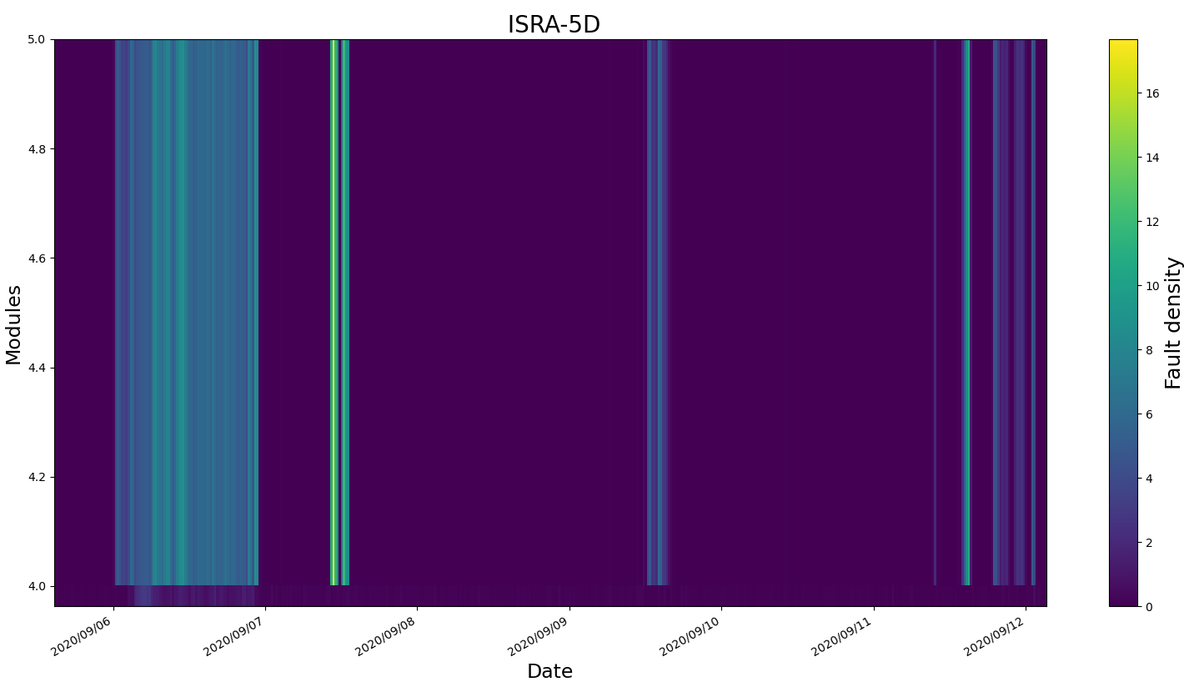
Exploring fault density by modules at the coating region

Slide 21
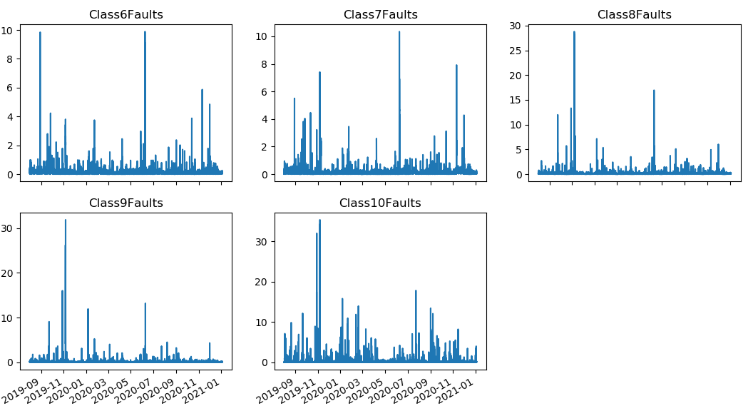
ISRA5D Fault Data
Focusing only on ‘Class Faults’.

Slide 22
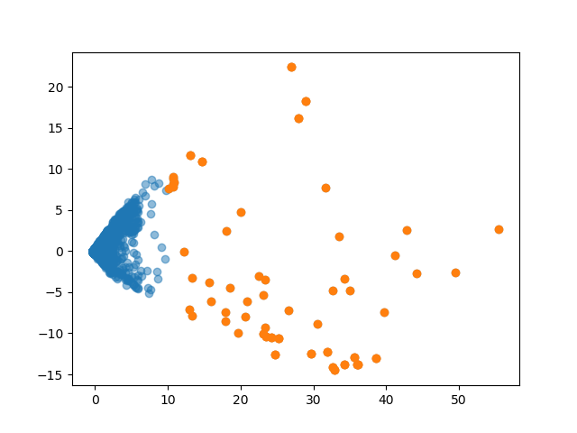
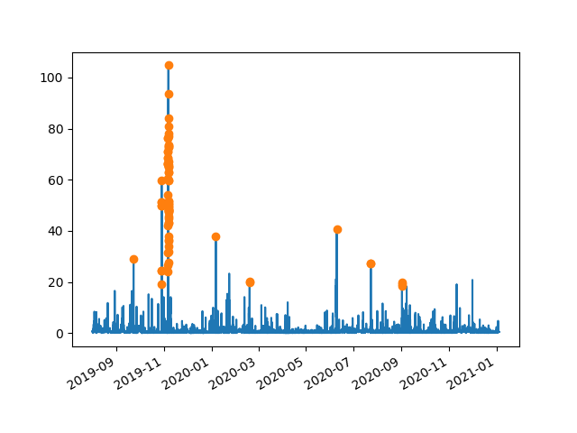
ISRA5D Fault Data
Focusing only on ‘Class Faults’.

Slide 23
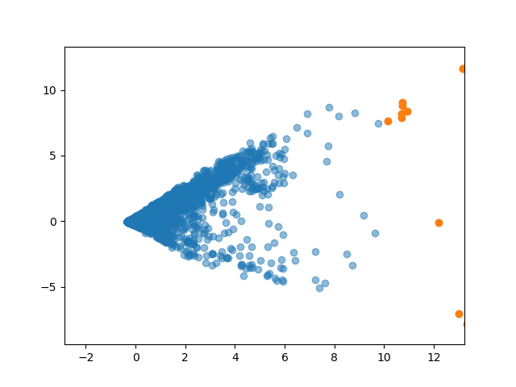
ISRA5D Fault Data
Focusing only on ‘Class Faults’.

Slide 24
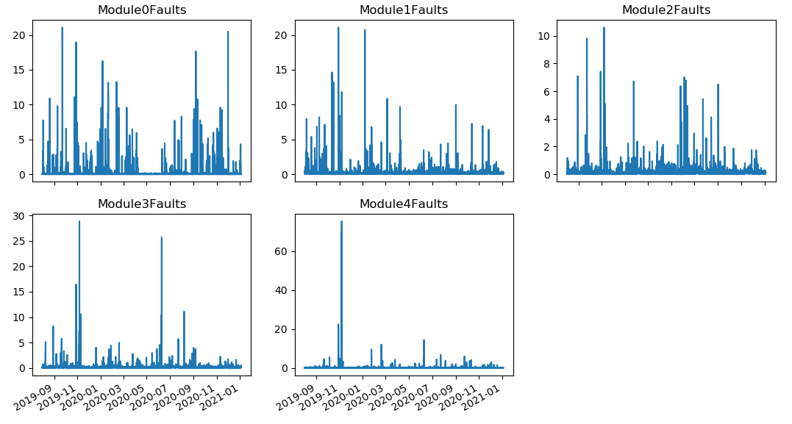
ISRA5D Fault Data
Now focusing only on ‘Module Faults’.

Slide 25
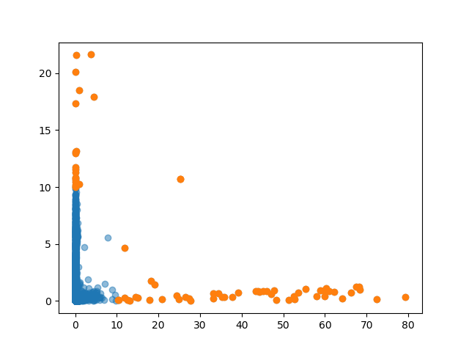
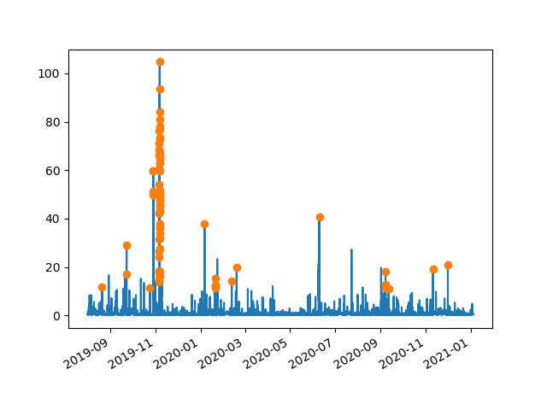
ISRA5D Fault Data
Now focusing only on ‘Module Faults’.

Slide 26
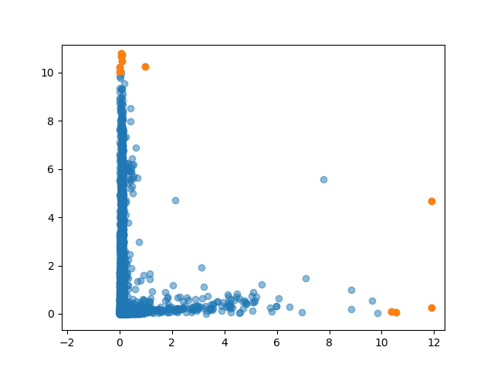
ISRA5D Fault Data
Now focusing only on ‘Module Faults’.

Slide 27
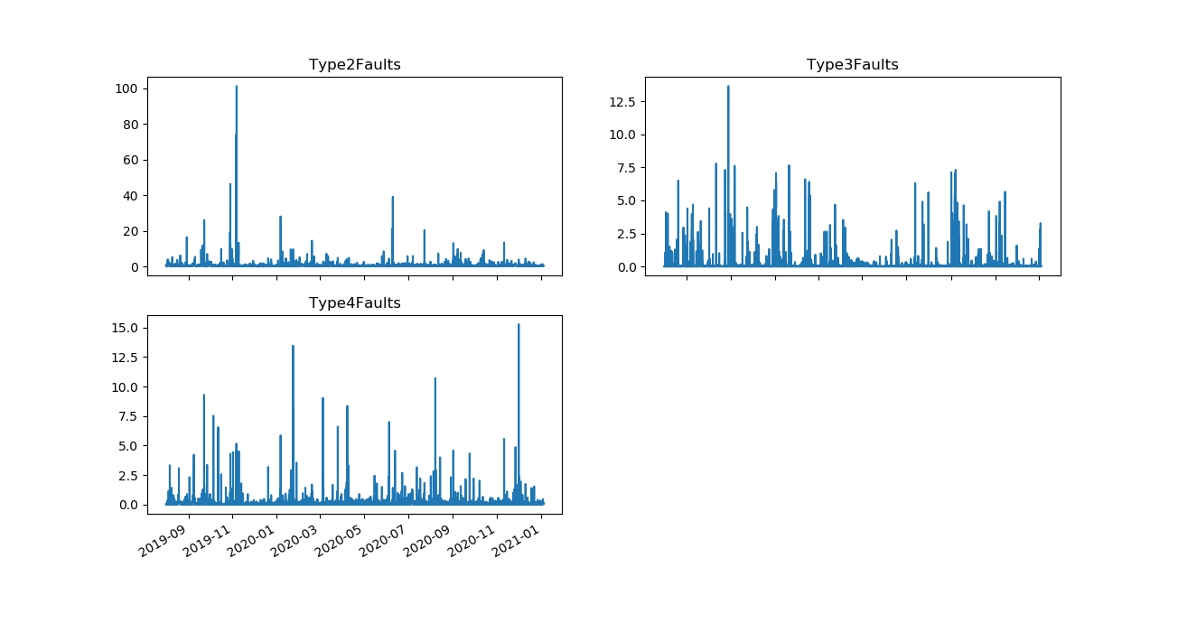
ISRA5D Fault Data
Now focusing only on ‘Faults Type’.

Slide 28
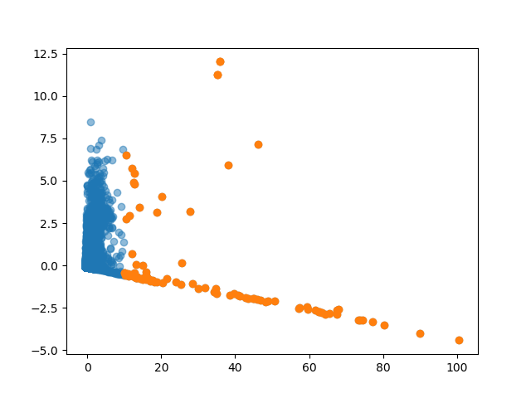
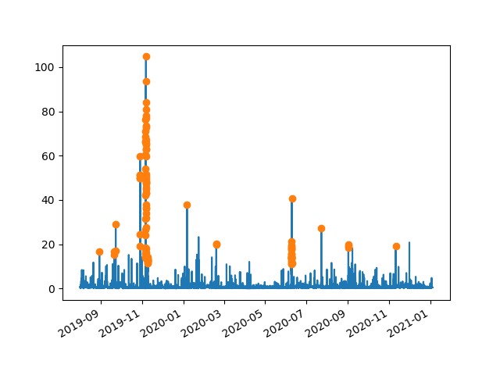
ISRA5D Fault Data
Now focusing only on ‘Faults Type’.

Slide 29
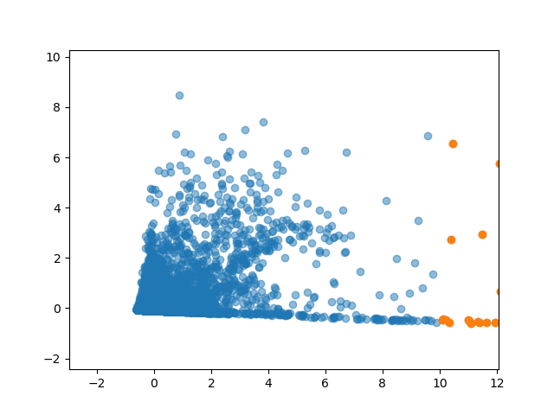
ISRA5D Fault Data
Now focusing only on ‘Faults Type’.

Slide 30
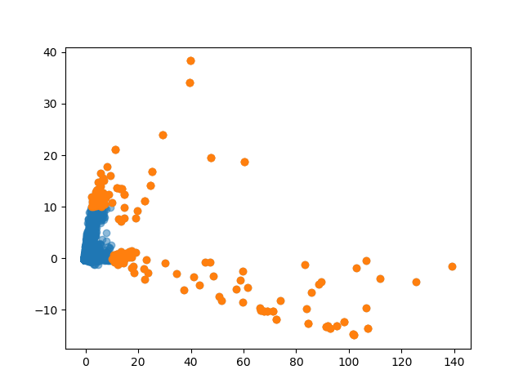
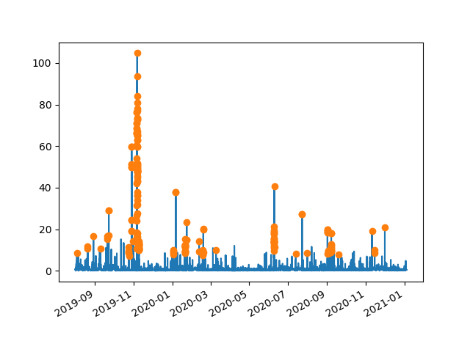
ISRA5D Fault Data
Including Class 6-10, Module 0-4, Type 2-4

Slide 31
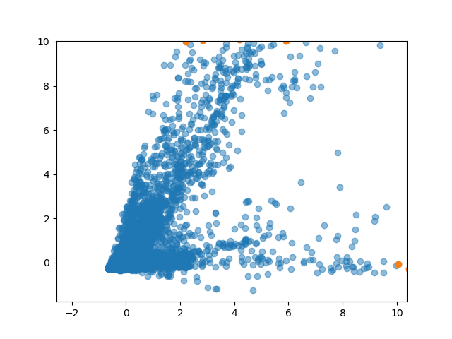
ISRA5D Fault Data
Including Class 6-10, Module 0-4, Type 2-4

Slide 32
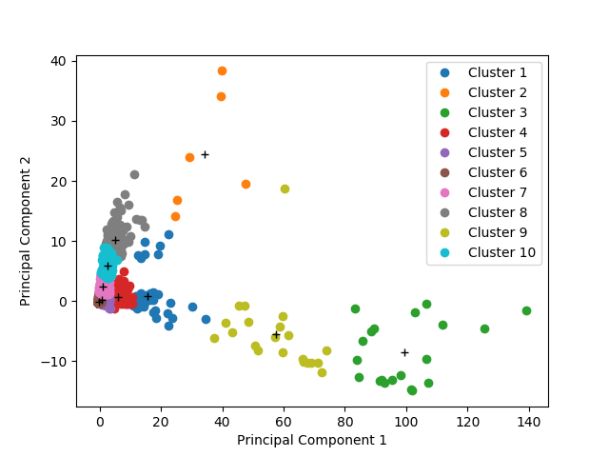
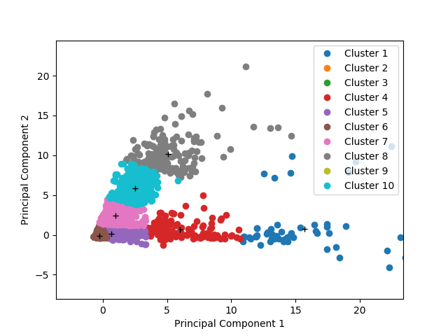
ISRA5D Fault Data
Including Class 6-10, Module 0-4, Type 2-4
Clustered into 10 clusters (k-means)

Slide 33
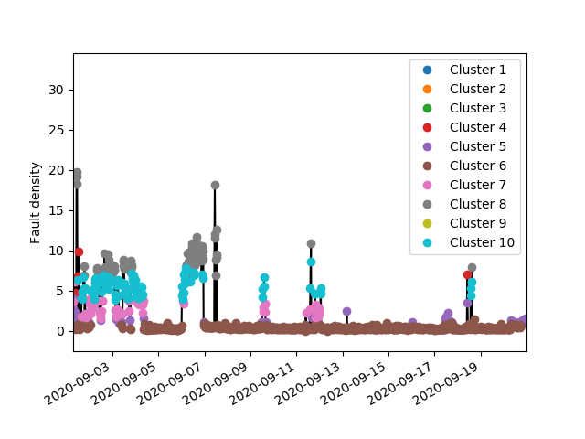
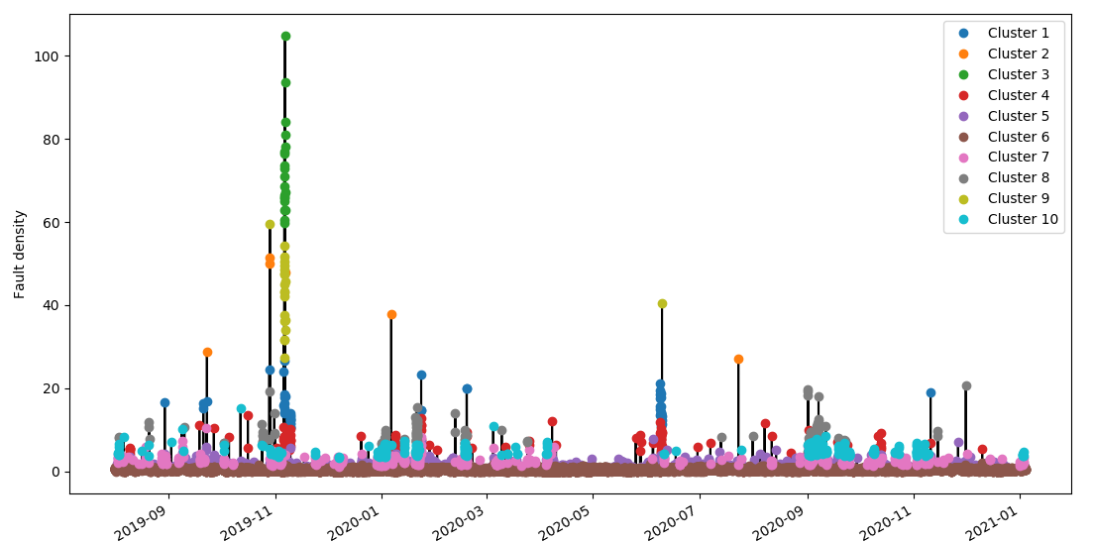
ISRA5D Fault Data
Including Class 6-10, Module 0-4, Type 2-4

Slide 34
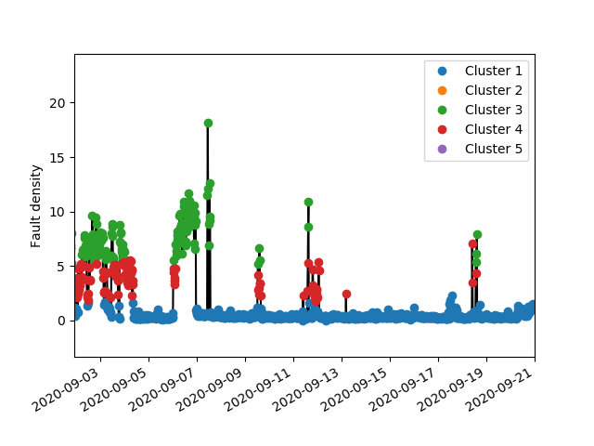
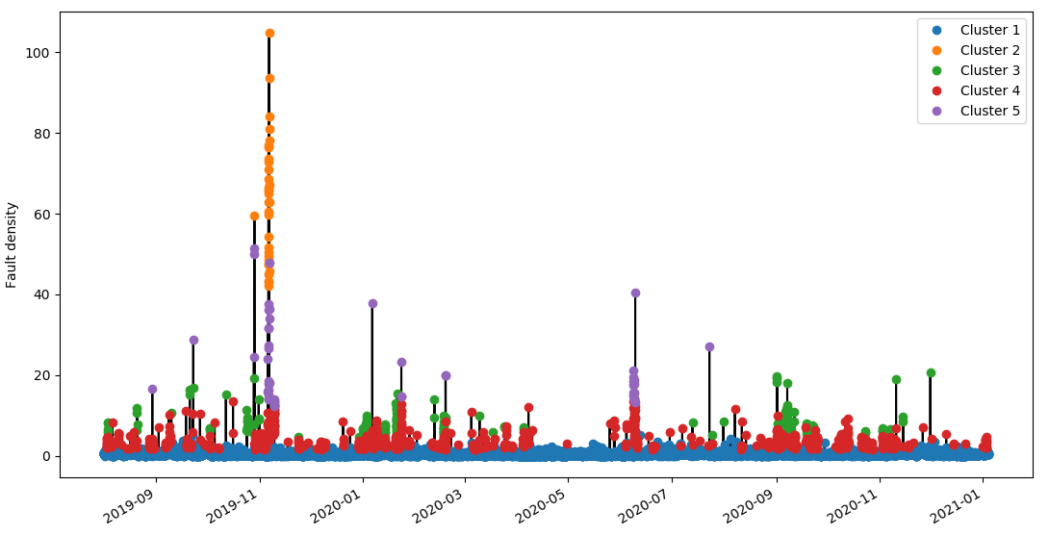
ISRA5D Fault Data
Including Class 6-10, Module 0-4, Type 2-4
Clustered into 5 clusters (k-means)

Slide 35
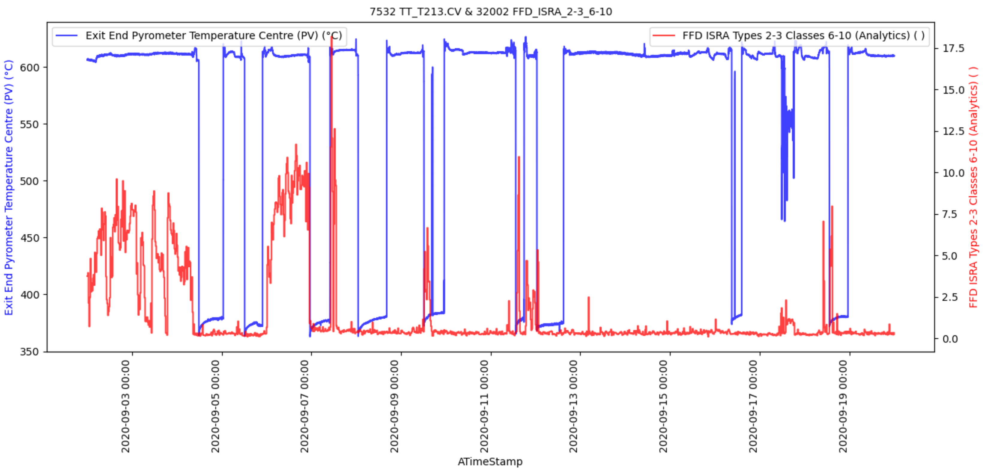

ISRA5D Fault Data
Coating related spikes

Slide 36
Thank you for your attention. ANY QUESTIONS?

